Slide 1
Chapter 4 Diatonic Chords in Major and Minor Keys
MUS 112
February 6 & 8, 2017

Slide 2
Introduction
We now have nine common chords that we are working with:
Four Triads
Major, Minor, Diminished, and Augmented
Five Seventh Chords
Major 7th, Minor 7th, Major-minor 7th, Half-diminished 7th, Diminished 7th
Diatonic Chords
Chords that are composed of notes exclusively from a given key
We call chords that have notes outside of the key, altered or chromatic.

Slide 3
Diatonic Triads in Major
We can construct a Triads on any scale degree
Reminder: we can only use notes in the given key
To indicate what scale degree is the root of a chord, we use Roman Numerals
There are seven scale degrees, so we need the first seven roman numerals
I, II, III, IV, V, VI, VII
The way we format the roman numeral indicates the quality of the triad

Slide 4
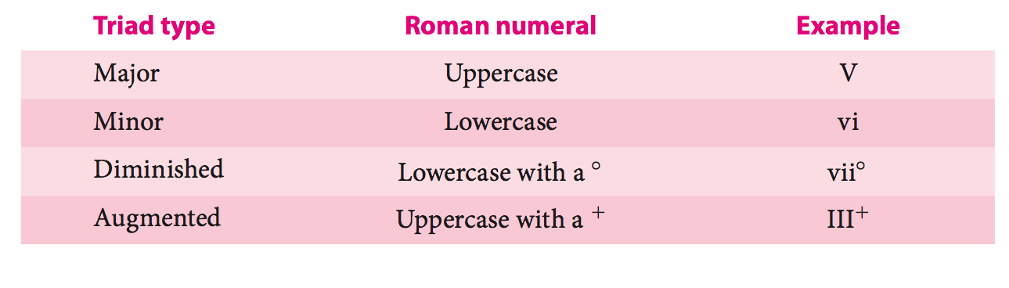

Slide 5
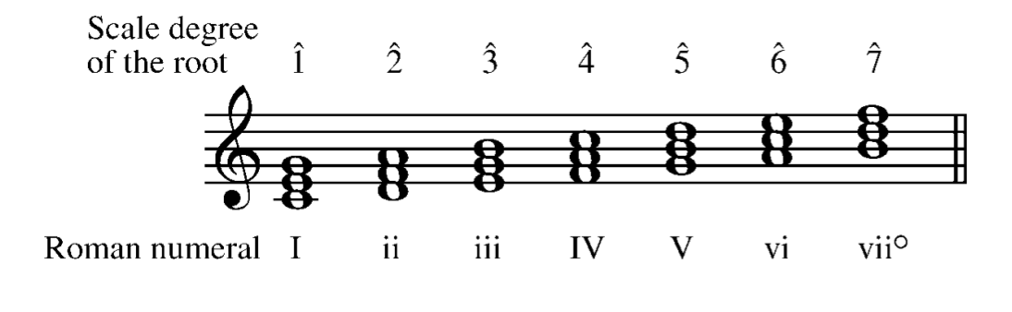
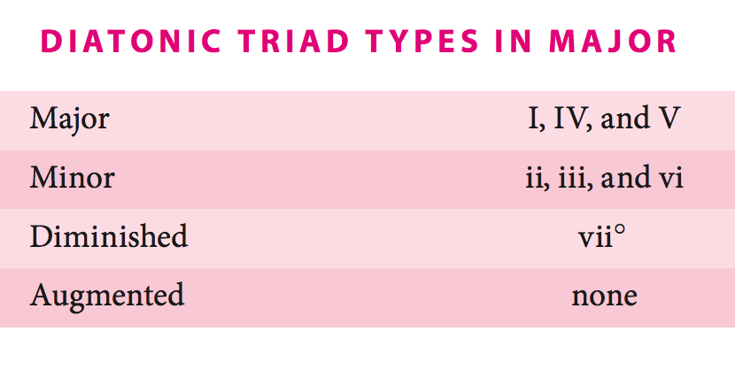

Slide 6
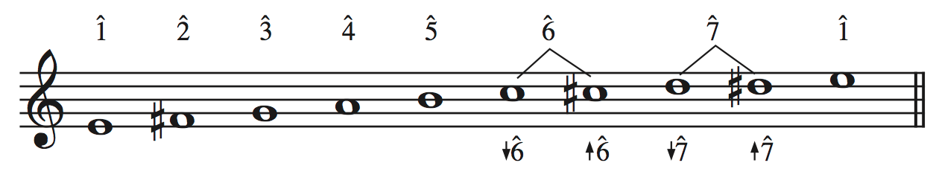
The Minor Scale
We have three minor scales to consider when looking at chords in minor keys
Natural
Harmonic
Melodic
What are the scale degrees that change between each scale?
^6 & ^7
Why?
Voice leading – raised ^6 and ^7 pull upward, and lowered ^6 & ^7 pull down
This allows a composer to create a certain direction in the musical line

Slide 7
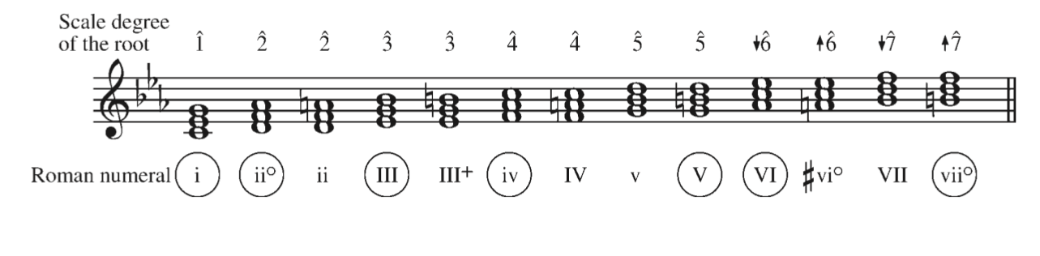
Diatonic Triads in Minor
There are more than 7 diatonic chords in minor
^6 and ^7 are variable.
All triads contain ^6 or ^7, except for what triad?
i
Math Time! How many diatonic triads are there in minor, if chords that have ^6 or ^7 have two options?

Slide 8
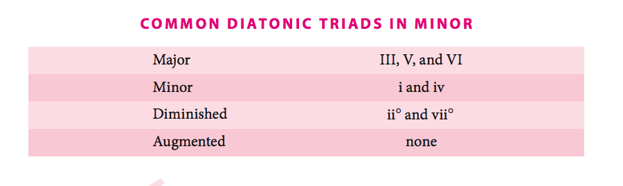
Qualities of Diatonic Triads in Minor

Slide 9
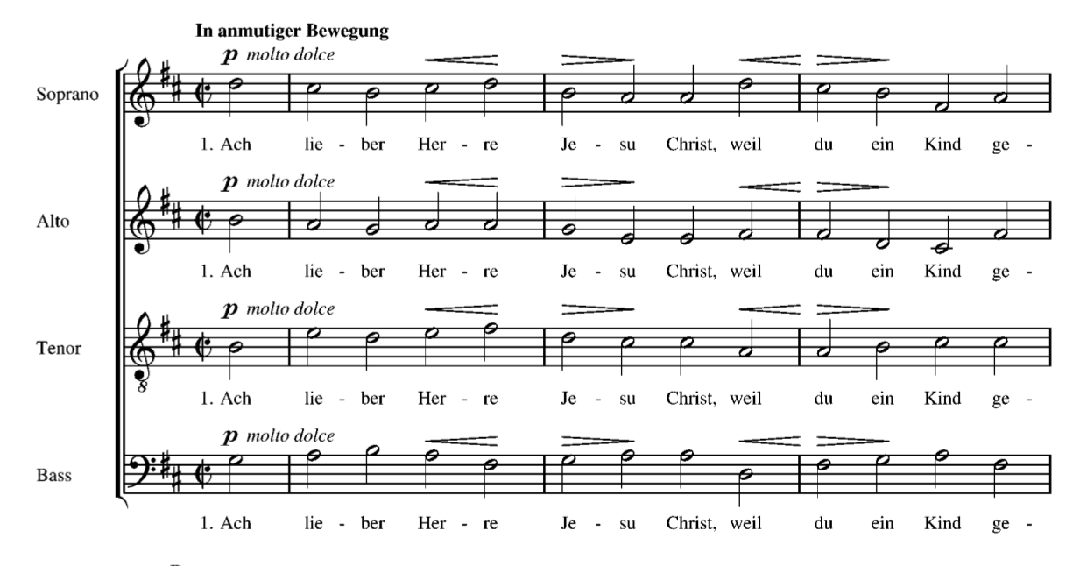
Brahms, Ach lieber Herre Jesu Christ

Slide 10
